Slide 1
Exercise 4
Cell Cycle, Mitosis and Meiosis

Slide 2
This exercise describes the events of the cell cycle and compares mitosis and meiosis. In addition to understanding the differences in the processes and outcomes of each mode of cell division and being able to answer questions about them, you should be able to recognize cells in different stages of mitosis. On this page you will find several photos of cells undergoing mitosis in the onion root and whitefish blastula. Use these images to test your ability to recognize the phases of mitosis and construct the sequence of events that are visible in these cells. Notice the differences between mitosis in plant and animal cells.

Slide 3
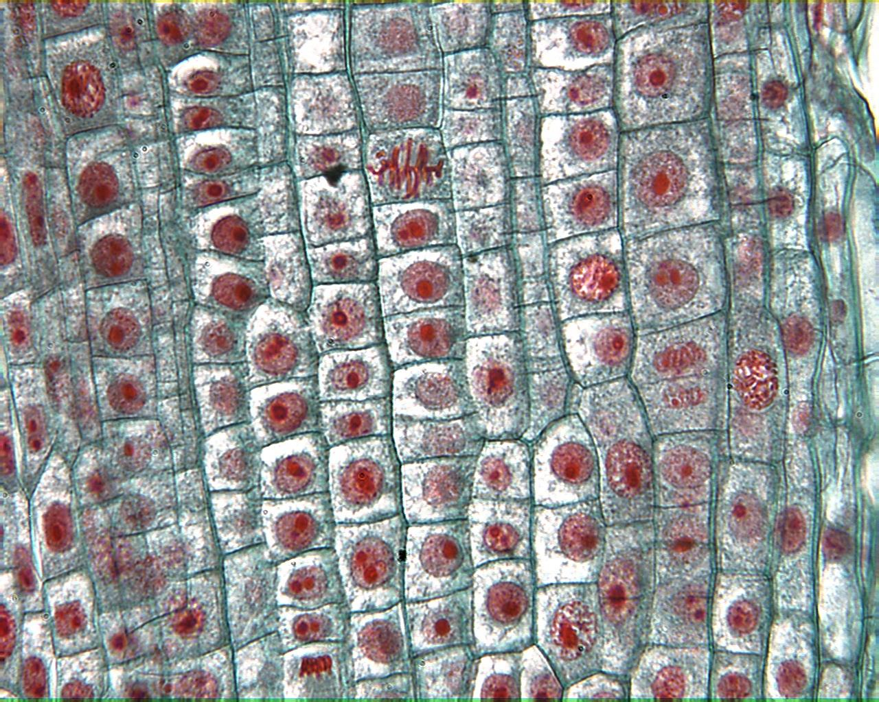
Onion Root

Slide 4
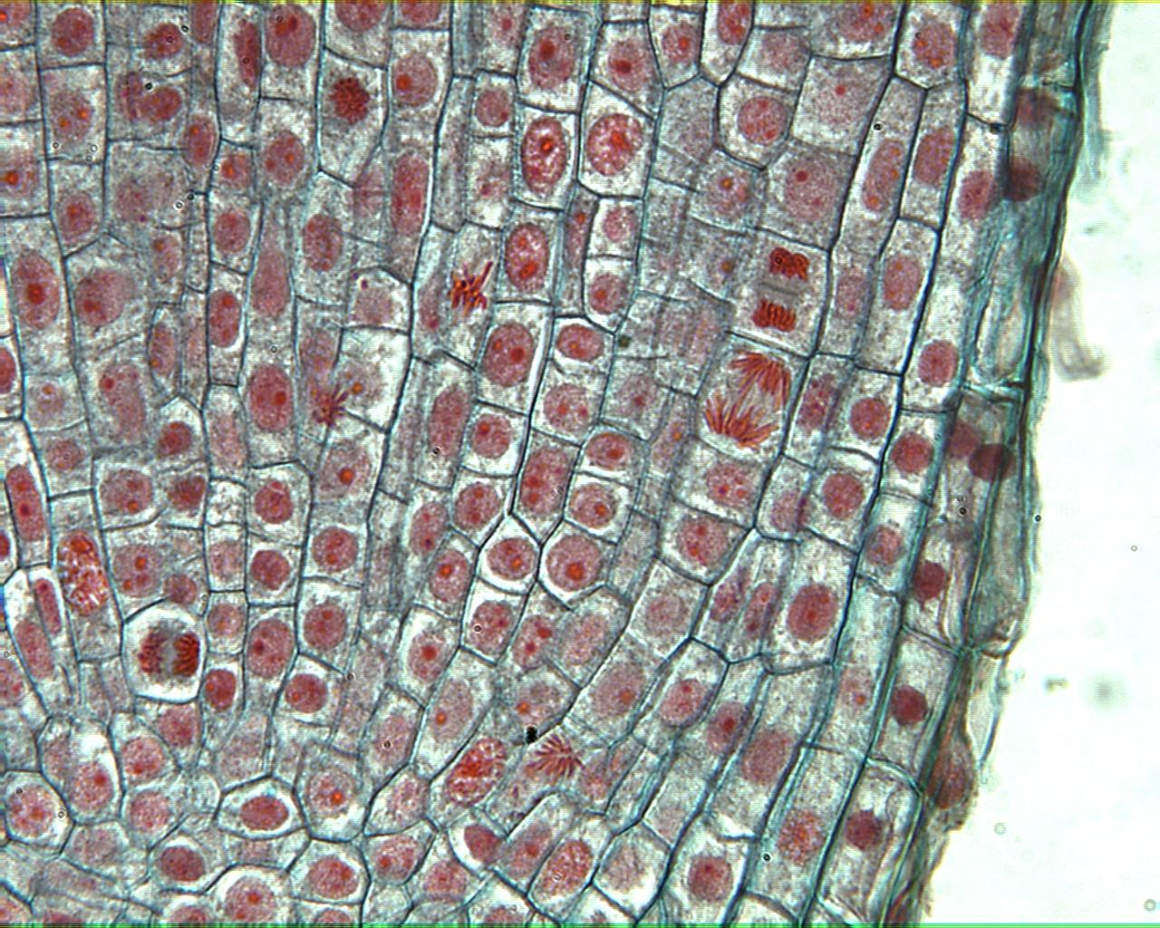
Onion Root

Slide 5
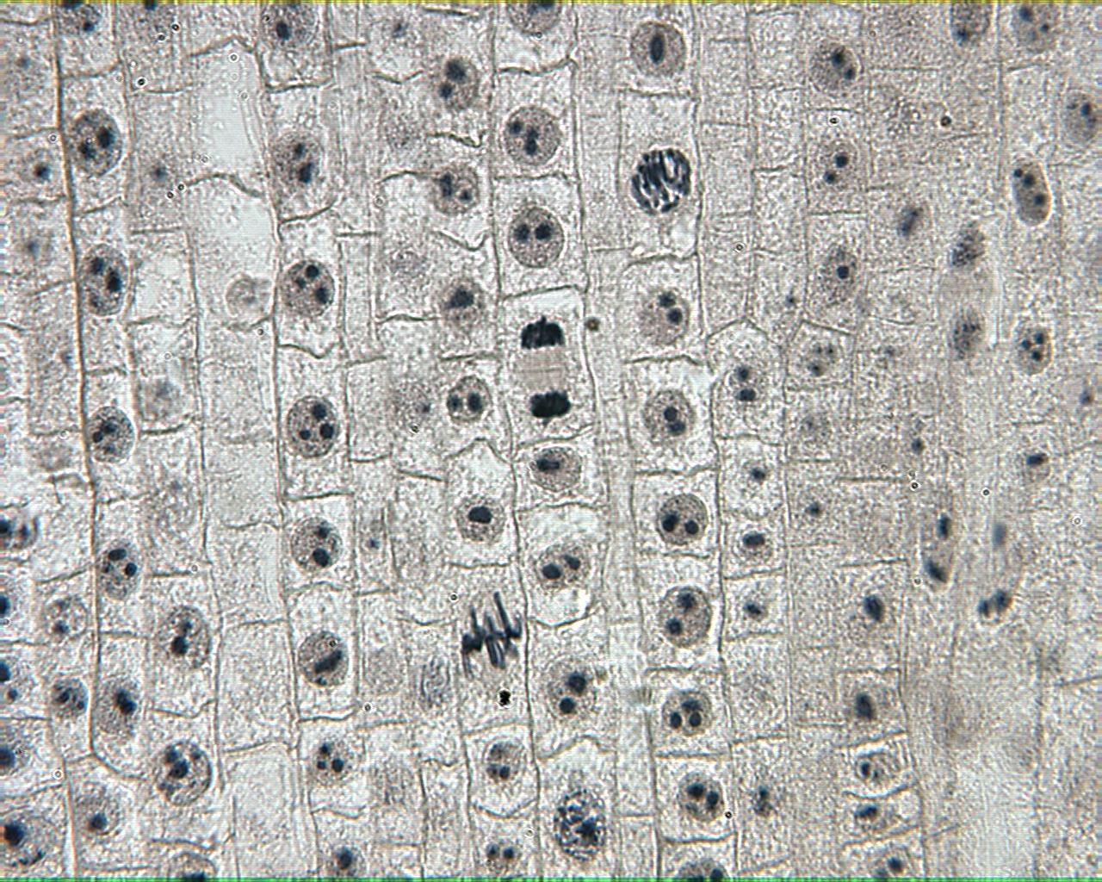
Onion Root

Slide 6
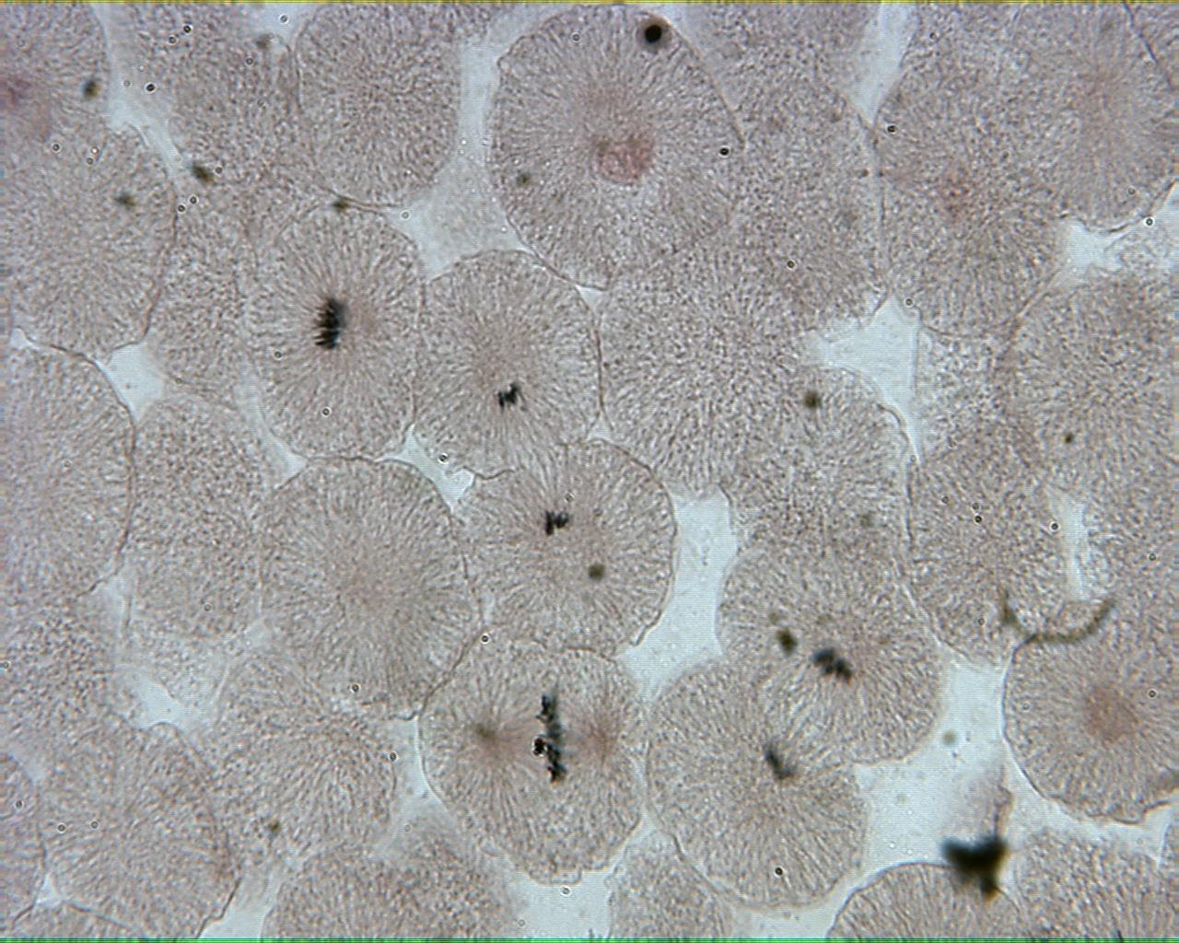
Whitefish Blastula

Slide 7
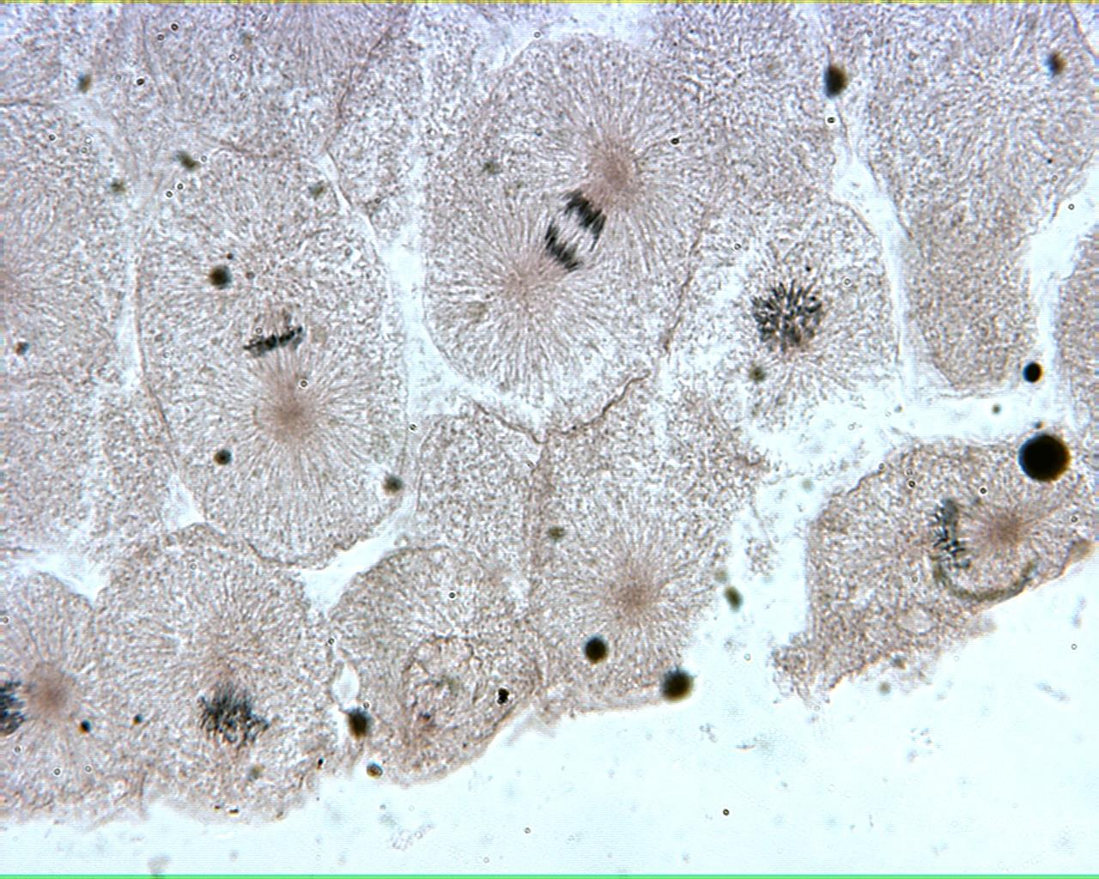
Whitefish Blastula

Slide 8
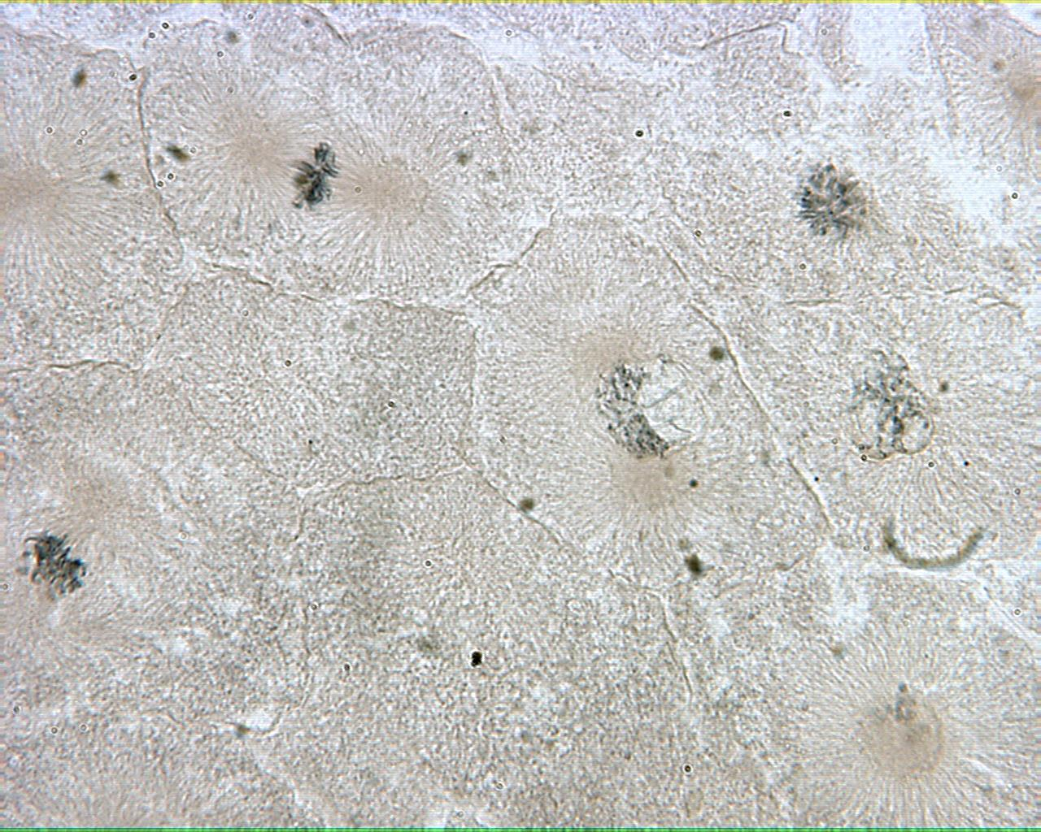
Whitefish Blastula

Slide 9
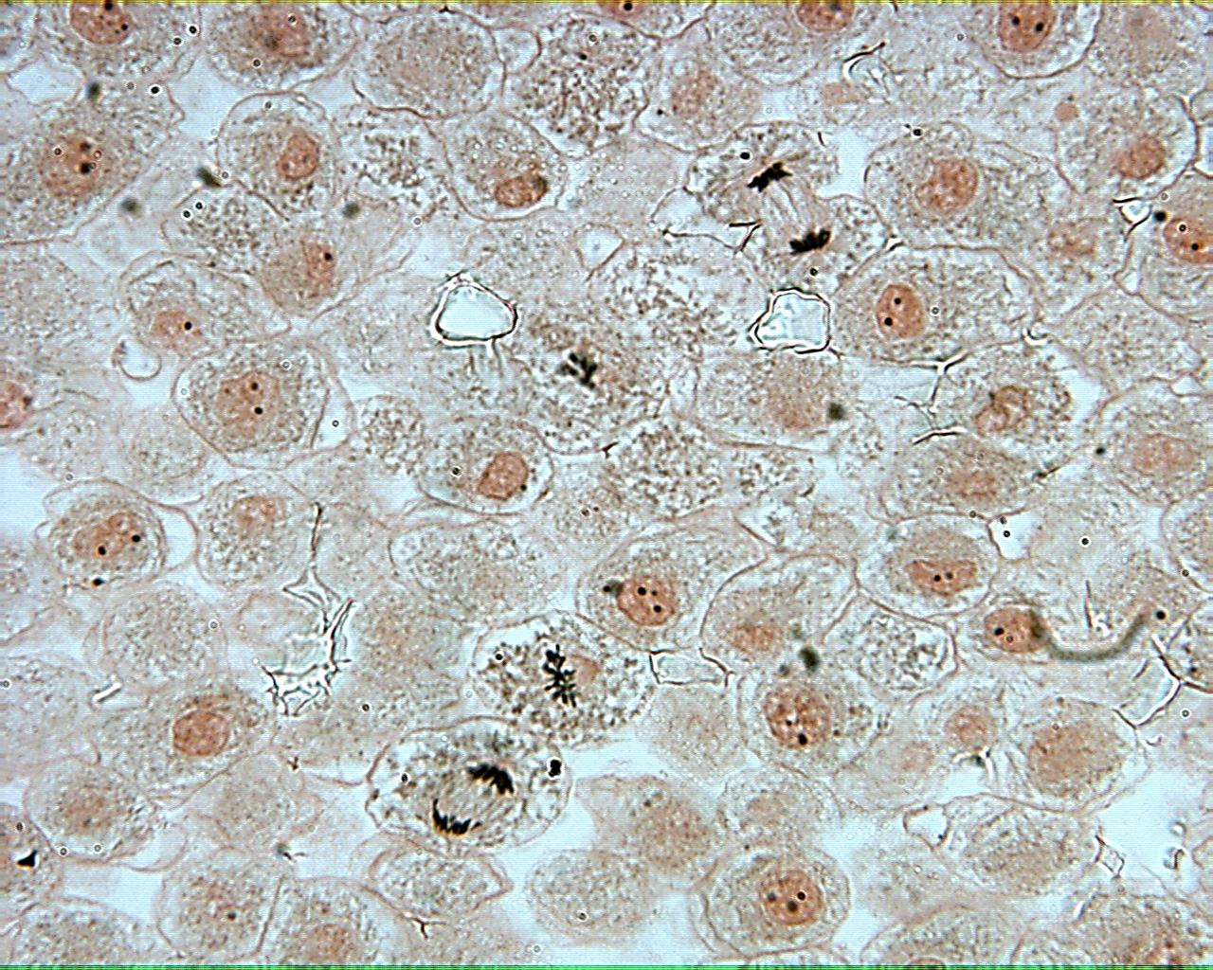
Whitefish Blastula

